Slide 1
DECISION TREE CLASSIFICATION (CHAID)
RAMYA J

Slide 2
CONTENTS
Introduction
Decision tree algorithm
How does it work?
Training a decision tree
Decision tree based methods
CHAID-Introduction
CHAID Technique
Mathematical approach to calculate chi square
Advantages and practical issues in decision tree
Real time examples of decision tree
Conclusion

Slide 3
INTRODUCTION
Decision tree is one of the easiest and popular classification algorithm to understand and interpret. Decision tress are a type of supervised machine learning where the data is continuously split according to a certain parameter. Decision tree learning are a collection of divide and conquer problem-solving strategies that use tree-like structures to predict the value of an outcome variable. Decision tree algorithm can be used for solving regression and classification problems too. The goal of using a decision tree is to create a training model that can use to predict the class or value of target variable by learning decision rules inferred from training data.

Slide 4
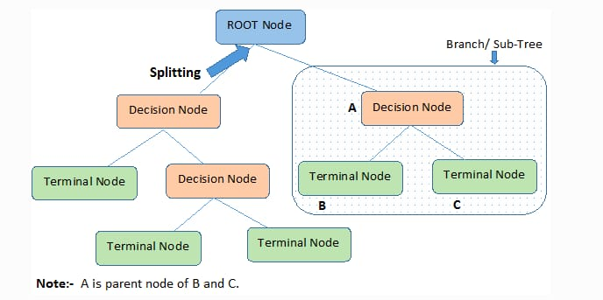
DECISION TREE ALGORITHM

Slide 5
ROOT NODE : represents the entire data which further gets divided into two or more homogeneous sets.
DECISION NODE : when a sub-node splits into further sub-nodes the it is called the decision node.
LEAF/TERMINAL NODE : represents the final output node, and the tree cannot be segregated further.
SPLITTING : is the process of dividing the decision node/root node into sub-odes according to the given conditions.
BRANCH/SUB-TREE : a tree formed by the splitting tree.
PRUNING : is the process of removing the unwanted branches from the tree.
PARENT/CHILD NODE : the root node is called the parent and the other nodes are called the child nodes.

Slide 6
EXAMPLE : CREDIT CARD FRAUD DETECTION
let us say it has three main attributes like AMOUNT, TIME, LOCATION and a class attribute here is FRAUD and has values like ‘yes’ or ‘no’.
All we need from decision tree is to find the function where the new transaction happened is said to be fraud or not.
FRAUD = function (AMOUNT, TIME, LOCATION).
AMOUNT
FRAUD
TIME
ATTRIBUTES
YES
NO
LOCATION

Slide 7
HOW DOES IT WORK?
TRAINING DATA
LEARNING ALGORITHM
LEARN MODEL
MODEL
TEST DATA
APPLY MODEL

Slide 8
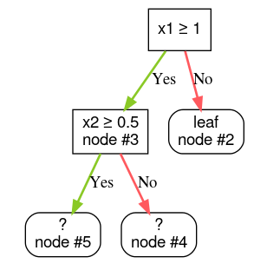
TRAINING A DECISION TREE
Step 1 : Create a root.
Step 2: Grow node #1. Say condition "x1 ≥ 1" was found. Two child nodes are created.
Step 3: Grow node #2. No satisfying conditions were found. So, make the node into a leaf.
Step 4: Grow node #3. Say condition "x2 ≥ 0.5" was found. Two child nodes are created.

Slide 9
DECISION TREE METHODS
DECISION TREE INDUCTION
Has many algorithms like :
Hunt’s algorithm, CART, CHAID, ID3, C4.5, SLIQ, SPRINT.
Greedy strategy : split the records based on an attribute test that optimizes certain criterion.
Issues:
How to split the records?
How to specify the attribute test condition?
How to determine the best split?
When to stop splitting?

Slide 10
How to specify test condition?
Depends on attribute types: nominal, ordinal, continuous.
Depends on number of ways of split: two way split, multi way split.
Splitting based on Continuous attributes
Discretization: to form ordinal categorical attribute. Divided into two types.
Static: discretize once at the beginning.
Dynamic: ranges can be found by equal interval bucketing, equal frequency bucketing (percentiles), or clustering
b) Binary Decision: is taken under threshold value (A<V) OR (A>=V).
Ex: taking 80k income as threshold value (>=80k), (<=80k)

Slide 11
How to determine the best split?
Ex: Before splitting we have 10 records of class 0 and 10 records of class 1
And has three attributes Own-Car, car-type, person ID.
….. ……. ……
Yes no Family sports luxury C1 C10 C11 C20
Difference 2 difference is more difference is very less
OWN-CAR
CAR-TYPE
PERSON ID
C0 : 6
C1 : 4
C0 : 4
C1 :6
C0 : 1
C1 : 3
C0 : 8
C1 :0
C0 : 1
C1 : 7
C0 : 1
C1 : 0
C0 : 1
C1 : 0
C0 : 0
C1 : 1
C0 : 0
C1 : 1

Slide 12
When to stop splitting?
Stop expanding a node when all the records belong to the same class.
Ex: Cheat classification
We can stop this tree as it is of no use having
Almost nearest values and are not having much
Of difference between them. yes(5%) no(5.5%)
Stop expanding a node when all the records have similar attributes.
Both having same attribute values should be
stopped
A
N1
N2
A
X
X
X
X
X
X

Slide 13
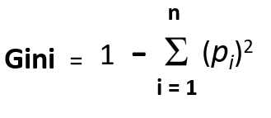
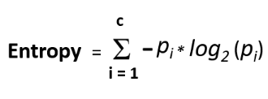
Decision tree splitting methods:
Gini Impurity: Gini Impurity is a method for splitting the nodes when the target variable is categorical. It is the most popular and the easiest way to split a decision tree. The Gini Impurity value is:
Entropy: Entropy is a measure of purity or the degree of uncertainty, impurity, or disorder of a random variable. It is, in essence, the assessment of impurity or unpredictability in data points.

Slide 14

c) Information Gain: refers to the process of identifying the most important features/attributes that convey the most information about a class. The entropy principle is followed with the goal of reducing entropy from the root node to the leaf nodes. Information gain is the difference in entropy before and after splitting, which describes the impurity of in-class items.
Information Gain = 1-Entropy
d) Chi-Square: Chi-square is another method of splitting nodes in a decision tree for datasets having categorical target values. It can make two or more than two splits. It works on the statistical significance of differences between the parent node and child nodes.

Slide 15
CHI-SQUARE AUTOMATIC INTERACTION DETECTOR
CHAID is a tool used to discover the relationship between variables. CHAID analysis builds a predictive model, or tree, to help determine how variables best merge to explain the outcome in the given dependent variable.
In CHAID analysis, nominal, ordinal, and continuous data can be used, where continuous predictors are split into categories with approximately equal number of observations.
CHAID creates all possible cross tabulations for each categorical predictor until the best outcome is achieved and no further splitting can be performed.

Slide 16
CHAID TECHNIQUE:
In the CHAID technique, we can visually see the relationships between the split variables and the associated related factor within the tree.
The development of the decision, or classification tree, starts with identifying the target variable or dependent variable; which would be considered the root.
CHAID analysis splits the target into two or more categories that are called the initial, or parent nodes, and then the nodes are split using statistical algorithms into child nodes.

Slide 17
Chi-square
Chi-Square is a statistical measure to find the difference between child and parent nodes. To calculate this we find the difference between observed and expected counts of target variable for each node and the squared sum of these standardized differences will give us the Chi-square value.
The formula of chi-square:-
√((y – y’)² / y’)
where y is actual and y’ is expected.

Slide 18
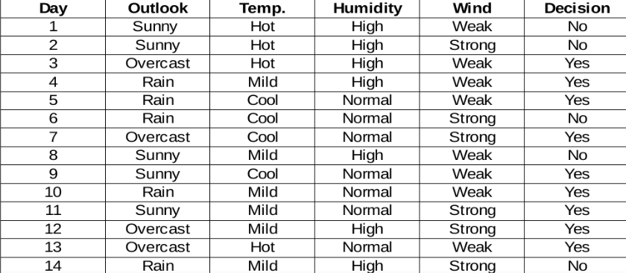
Example:
We need to find the most important feature w.r.t target columns to choose the node to split data in this data set.

Slide 19
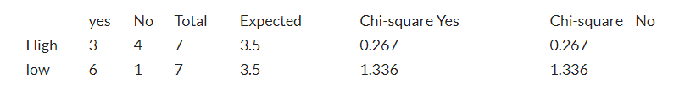
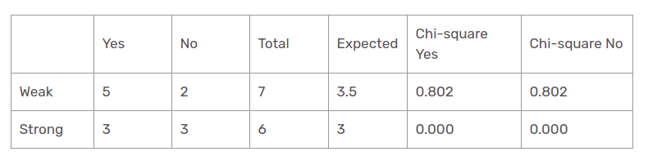
Humidity feature
Chi-square yes for high humidity is √(( 3– 3.5)² / 3.5) = 0.267
Chi-square yes for low humidity is √(( 6– 3.5)² / 3.5)=1.336
the chi-square value of the humidity feature is
= 0.267 + 0.267 + 1.336 + 1.336
= 3.207
Wind feature

Slide 20
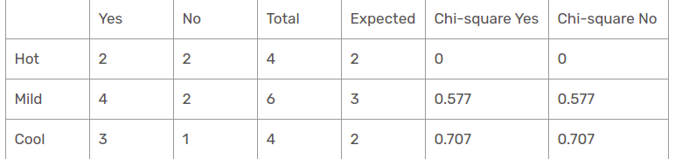
the chi-square test value of the wind feature is
= 0.802 + 0.802 + 0 + 0
= 1.604
Temperature feature:
the chi-square test value of the temperature feature is
= 0 + 0 + 0.577 + 0.577 + 0.707 + 0.707
= 2.569

Slide 21
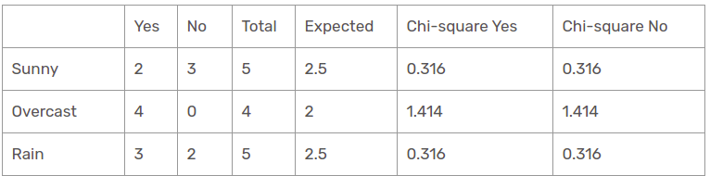
Outlook feature:
the chi-square test value of the outlook feature is
= 0.316 + 0.316 + 1.414 + 1.414 + 0.316 + 0.316
= 4.092
the outlook column has the most elevated and highest chi-square value. This implies that it is the main component feature. Along with these values, we will put this feature to the root node.
OUTLOOK
SUNNY
OVERCAST
RAIN

Slide 22
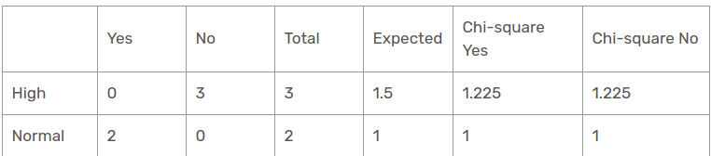
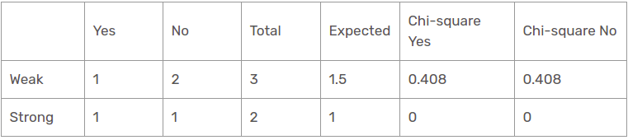
Humidity feature for when the outlook is Sunny
Chi-square value of humidity feature for sunny outlook is
= 1.225 + 1.225 + 1 + 1
= 4.449
Wind feature for when the outlook is Sunny

Slide 23
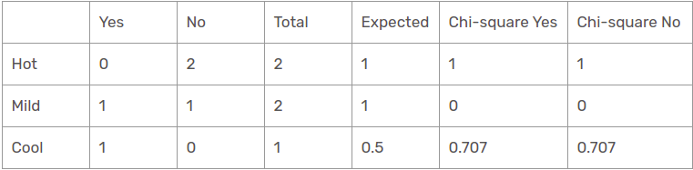
Chi-square value of wind feature for sunny outlook is
= 0.408 + 0.408 + 0 + 0
= 0.816
Temperature feature for when the outlook is Sunny
the chi-square value of temperature feature for sunny outlook is
= 1 + 1 + 0 + 0 + 0.707 + 0.707
= 3.414
humidity is the most predominant feature for the sunny outlook branch. We will put this feature as a decision rule.

Slide 24
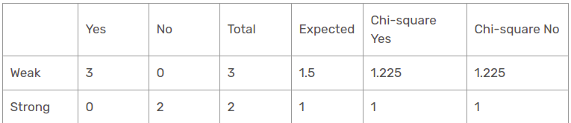
Wind feature for rain outlook
OUTLOOK
SUNNY
OVERCAST
RAINY
HUMIDITY
HIGH
NORMAL

Slide 25
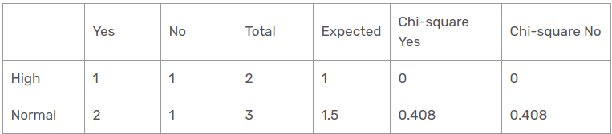
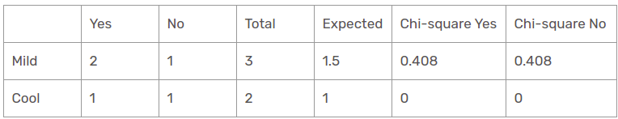
the chi-square value of wind feature for rain outlook is
= 1.225 + 1.225 + 1 + 1
= 4.449
Humidity feature for rain outlook
Chi-square value of humidity feature for rain outlook is
= 0 + 0 + 0.408 + 0.408
= 0.816
Temperature feature for rain outlook

Slide 26
Chi-square value of temperature feature for rain outlook is
= 0 + 0 + 0.408 + 0.408
= 0.816
the wind feature is the victor for the rain is the outlook branch. Put this column in the connected branch and see the corresponding sub informational dataset.
OUTLOOK
SUNNY
OVERCAST
RAINY
HUMIDITY
WIND
HIGH
NORMAL
WEAK
STRONG

Slide 27
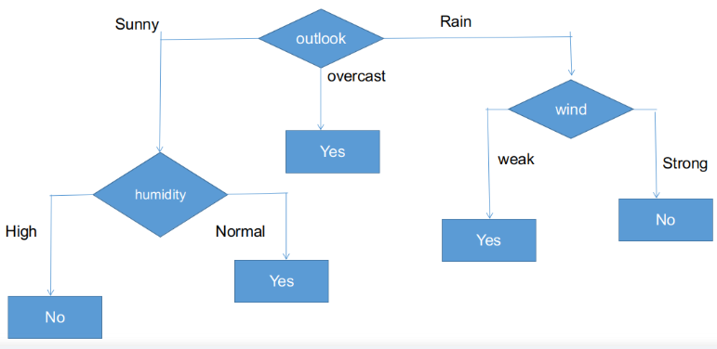
As seen, all branches have sub informational datasets having a single decision such that yes or no. In this way, we can generate the CHAID tree as illustrated below.

Slide 28
ADVANTAGES AND PRACTICAL ISSUES
ADVANTAGES:
Inexpensive to construct.
Extremely fast at classifying unknown records.
Easy to interpret for small-sized trees.
Accuracy is comparable to other classification technique for many simple datasets.
More flexible.
PRACTICAL ISSUES:
Under fitting due to large training and test errors.
Over fitting due to complexity, noise, insufficient data
Missing values.
More costly to train.

Slide 29
REAL TIME EXAMPLES
Predicting tumor cells as benign or malignant.
Classifying credit card transactions as legitimate.
Classifying secondary structures of protein as alpha-helix, beta-sheet, or random coil.
Categorizing news stories as finance, weather, entertainment, sports, etc.
Emails, spam or inbox.
Predict loan eligibility process for given data.
Shortlisting of a student based on his merit score, attendance, etc.

Slide 30
CONCLUSION
Decision trees help you to evaluate your options. Decision trees are excellent tools for helping you to choose between several courses of action. They provide a highly effective structure within which you can lay out options and investigate the possible outcomes of choosing those options. Decision trees are extremely useful for data analytics and machine learning because they break down complex data into more manageable parts. They're often used in these fields for prediction analysis, data classification, and regression.

Slide 31
THANK YOU

